Slide 1
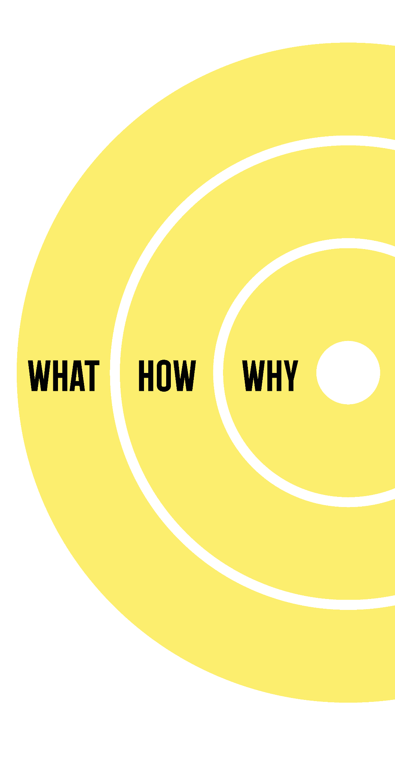
WHY
Our mission is to improve health and quality of life by making a healthy lifestyle second nature. We empower people to take control of their well-being through preventive and integrative care, fostering a culture where wellness is a priority and transforming lives for the better.
HOW
We take an integrative medicine approach, combining the best global health trends with a commitment to high-quality products and services. Through continuous education for both customers and professionals, we empower informed decisions about health and wellness. Our strong partnerships with major global suppliers and healthcare professionals ensure we stay ahead of industry innovations. With customer centricity at the heart of our business, we prioritize their needs through personalized care in our own wellness stores and sustainable practices. Guided by ethics and a commitment to agile, collaborative teamwork, we focus on constant improvement across all areas, from route to market to differentiated marketing strategies that leverage communities, word of mouth, and tech-savvy solutions. All of this is driven by a highly skilled team with deep industry expertise, ensuring we deliver a truly unique and impactful wellness experiences.
WHAT
We offer a comprehensive range of premium health and wellness products, carefully selected for their high quality and effectiveness. Our portfolio includes both imported and own-brand food supplements, wellness foods, and health products that support preventive and integrative care. Through our own wellness stores and eShop, we deliver personalized health solutions tailored to individual needs. With in-store consultancy services and high availability nationwide, we ensure everyone has access to the best tools and expertise they need to lead healthier, more balanced lives.
Notes:
Let’s suppose someone offers to buy your company at a fair price. Let’s also suppose this buyer is intent on killing your company after the purchase. Your products and services will be immediately discontinued. All operations will be shut down. The brand will be shelved forever. Your company will completely cease to exist.
Try to answer the following questions in order to articulate what your company brings to the world:
• What will be lost if your brand ceased to exist? - e.g. A sixty-year legacy of innovation and entrepreneurship
• Why is it important that your brand continues to exist? - e.g. Because our company will enhance people’s quality of life
• What’s at stake here? - e.g. Increased congestion, pollution and space taken up by vehicles

Slide 2
Imagine it is 5 years from today and answer the following questions:
What have you achieved? | We have established an extensive product portfolio that offers a 360-degree approach to health, solidifying our position as the largest wellness chain in the market with 75 stores and over 1 million customers annually. Our own brand, Good Routine, now holds a 25% share in the business, covering three product categories and actively operating in 10 international markets. For 8 consecutive years, we’ve been the undisputed quality leader, and we are widely recognized as the industry’s leader. Our commitment to excellence is further reflected in our lean, digitalized, and automated processes, ensuring efficiency and growth. As we continue to refine our Route to Market and prioritize customer-centricity, we remain focused on setting the highest standards in the industry."
What do customers say about you? | Customers describe us as their most trusted partner in well-being, recognizing our commitment to providing premium, high-quality products. They appreciate our team of energetic, passionate, and solution-oriented professionals who truly care about their health. Our solid business ethics, combined with an innovative approach and deep expertise, make us stand out as a competent and reliable choice. With easy access to our products and services, customers feel confident knowing they are supported by a company dedicated to improving their overall well-being.
What do your employees say? | Our employees are proud and thrilled to be part of a company where they feel a true sense of professional purpose that aligns with their personal mission and values. They are motivated by continuous opportunities for personal learning and development, knowing that their ideas and contributions truly matter. They feel appreciated and joyful, working in an environment that fosters growth and meaning every day."
What is your Market position? | We are proud to hold a top 3 position in the supplements market, while leading the health store sector as the number 1 in both store count and consumers reached. Our own brand, Good Routine, ranks among the top 10 in the supplements market, and we are also positioned in the top 10 for wellness foods in modern trade, reinforcing our leadership in the health and wellness industry.
How do your offices look like? | Our offices remain in the same location, but we’ve expanded to take over the entire floor, optimizing the space for efficiency and collaboration. The design has been upgraded with a sustainable approach, incorporating modern elements that reflect our wellness ethos. We’ve created dedicated spaces for fitness, meditation, and yoga, along with collaborative areas that foster teamwork and innovation, ensuring our work environment aligns with our mission of health and well-being.
What capabilities does the achievement provide you with? | Our success has equipped us with robust sales and distribution capabilities, both in retail and across new markets. We’ve strengthened our ability to develop and sell new product categories, while also enhancing our skills in talent management, customer acquisition, and market penetration. With AI-integrated technology, we now offer hyper-personalized solutions and maintain a strong focus on customer centricity. Our team excels in brand building through marketing and innovation, backed by solid financial expertise. As we refine our route to market, we continue to foresee future trends and adapt swiftly, ensuring we remain industry leaders.
Notes:
KNOW THYSELF: MY DREAM [PAGE 1 out of 3]

Slide 3
Imagine it is 5 years from today and answer the following questions:
How does it feel to achieve your dream? | Achieving this dream feels incredibly fulfilling and joyful. It brings a sense of pride and empowerment, knowing we’ve made a lasting impact. We feel energized and grateful for the journey, blessed to have built something that others trust and believe in. This achievement reflects a shared purpose, making us even more committed to the path ahead.
How does the team feel about the achievement of your dream? | The team feels an immense sense of pride and motivation, deeply connected to the mission we’ve accomplished together. They are excited about the positive impact we’ve made and energized by the shared sense of purpose. There is a strong feeling of accomplishment, enthusiasm, and unity, with everyone fully engaged, committed, and empowered. The team is inspired and driven by the journey, and the collective achievement fills them with a great sense of fulfillment.
What is your own personal achievement? | My personal achievement lies in taking better care of my own life and lifestyle, while finding a profound sense of professional purpose. I've reached a great mental state, experienced career success, and grown personally, all while creating a lasting legacy. As a visionary leader, I've inspired positive change, built a high-performance team, and contributed to a future that aligns with both my personal and professional values.
Who is the person you have become along this journey? | Through this journey, I’ve become a lifelong learner and a more confident leader, resilient and adaptable in the face of challenges. I’ve developed a deep sense of focus, balance, and mindfulness, driving my actions with purpose. I now empower others to believe in their potential, with a profound commitment to well-being and being a catalyst for positive change. Curiosity continues to guide me, and I feel grateful for the growth and fulfillment this journey has brought.
Notes:
KNOW THYSELF: MY DREAM [PAGE 1 out of 3]

Slide 4
Describe your dream story
In 5 years, we are at the forefront of a wellness revolution, transforming the way people take charge of their health. What began as a bold vision has evolved into a movement that has redefined how health and well-being are experienced and prioritized in everyday life. Our mission is clear: we empower people to live healthier, more fulfilling lives by making a healthy lifestyle second nature. Through preventive and integrative care, we foster a culture where wellness is at the forefront. Our products, services, and experiences are designed to improve the health, vitality, and quality of life of individuals and families around the world. Today, we have built an extensive product portfolio offering a 360-degree approach to health, positioning ourselves as the leader in the wellness industry. With 75 of our own wellness stores across the country, serving over 1 million customers annually, we’ve made well-being accessible and essential. Our brand, Good Routine, now holds a 25% share in our business covering three product categories, and operates successfully in 10 international markets. For 8 years, we’ve maintained our standing as the undisputed leader in quality, a recognition that reflects our relentless commitment to excellence. Our impact is felt beyond products. We provide personalized health solutions and in-store consultancy services, guiding our customers toward better health. Every interaction—whether in-store or through our eShop—carries the promise of expert advice and premium, high-quality products that are effective and trusted. Our lean, automated processes ensure we stay ahead in efficiency, and our route to market is refined to deliver our unique offerings to as many people as possible. Customers describe us as a trusted partner in their wellness journey. They trust the quality of our products and appreciate the energy, passion, and dedication of our team. With strong business ethics, innovation at the core, and a solution-oriented approach, we stand out as a reliable and inspiring choice in the health and wellness industry. Our team is the heartbeat of this journey. Proud, motivated, and deeply connected to our mission, they feel a profound sense of accomplishment and unity. Every day, they are energized by the purpose we’ve cultivated, fully engaged in driving our shared vision forward. Our employees find personal and professional fulfillment here, thriving in a culture of continuous learning and meaningful contribution. Their ideas matter, and they take joy in being part of a movement that is transforming lives. Our offices are a reflection of who we are—sustainable, efficient, and designed to foster collaboration. We’ve expanded to take over the entire floor, creating spaces for fitness, meditation, and innovation. The design aligns with our wellness ethos, ensuring that our environment reflects the values we stand for. The capabilities we’ve built are remarkable. Our sales and distribution network is strong, with a robust retail presence and a growing ability to develop new product categories. Talent management has become a core strength, enabling us to attract and retain top talent, while our AI-integrated technology allows for hyper-personalized health solutions. Our customer-centric approach remains unwavering, and we continue to anticipate future trends, ensuring we stay ahead in a constantly evolving industry. Achieving this dream feels deeply fulfilling. It brings us joy, pride, and a sense of empowerment, knowing we’ve made a lasting impact on the world of health and well-being. We are energized and grateful for the journey, and this shared achievement strengthens our commitment to continue pushing boundaries. We are not just a company—we are a catalyst for positive change, and every day we continue to shape the future of wellness. Our vision is bold, but it’s real, and we are living it today.
If you are to tell your dream story to a friend with 1 sentence, what would it be:
Our dream is to revolutionize health and well-being by making a healthy lifestyle second nature for everyone, through innovative, high-quality products and personalized solutions that transform lives.
Notes:
KNOW THYSELF: MY DREAM [PAGE 1 out of 3]

Slide 5

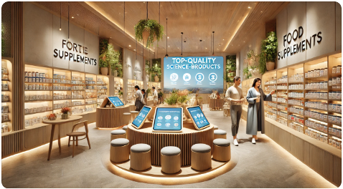
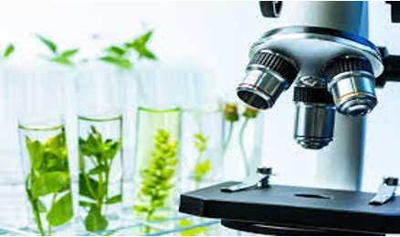
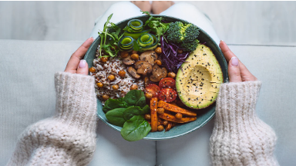
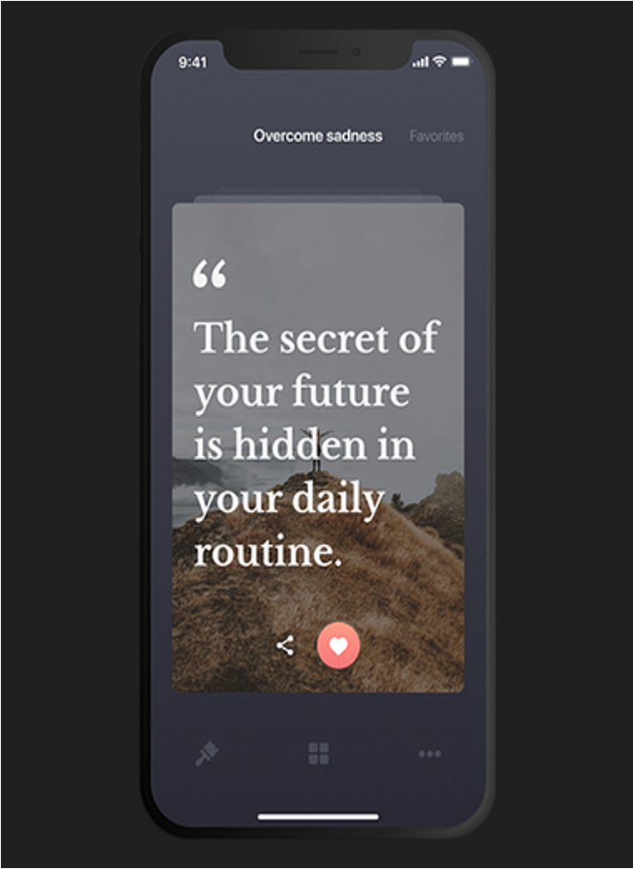




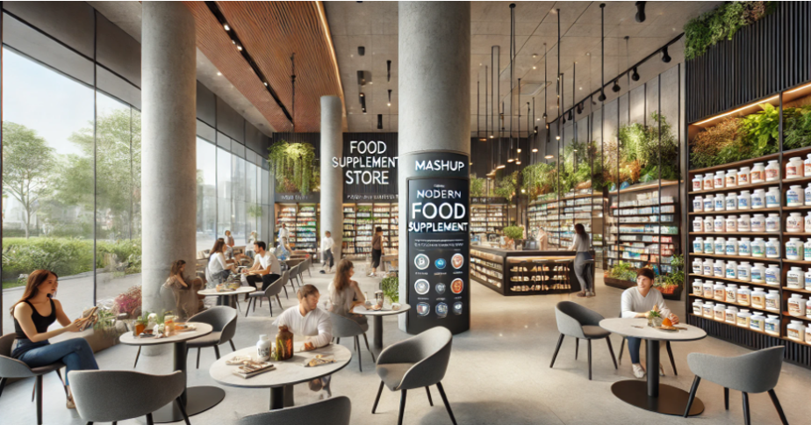
[MODULE:INDIVIDUAL AND COMPANY IDENTITY - SPRINT:DREAM]
List 7-10 words that best describe your dream | The people that could be associated with your dream
Transformative – our dream is about fundamentally changing how people approach health and well-being. Wellness – At the heart of our vision is promoting a balanced, healthy lifestyle. Empowering – we aim to empower people to take charge of their health through personalized solutions. Innovative – our approach incorporates cutting-edge trends & technologies in health & wellness. Health-focused – our mission centers around improving health and quality of life. Holistic – we take a 360-degree approach, addressing physical, mental, and spiritual health. Purpose-driven – Everything we do is driven by a deeper sense of purpose to positively impact lives. Sustainable – our vision includes sustainable practices that ensure long-term health and environmental responsibility. Personalized – we offer tailored health solutions, meeting individual needs. Inspiring – Your dream inspires both our customers and our team to strive for better health and well-being. | Bill Gates – for his passion for learning and curiosity. David Sinclair – for his groundbreaking research and innovation in health and longevity. Steve Jobs – for his visionary thinking and simplicity in execution. Brian Johnson – for his remarkable discipline and commitment to optimizing health. Elon Musk – for bold dreaming and fearless implementation. Michelle Obama – for her advocacy of health, wellness, and empowerment. J.K. Rowling – for her storytelling joy and pursuit of a balanced lifestyle Richard Branson – for his daring entrepreneurial spirit. Mother Teresa – for her caring spirit and dedication to others’ wellbeing. David Popovici – for his discipline, persistence, and pursuit of excellence. Howard Schultz – for his vision in creating an iconic global brand with a strong sense of community.
Select 7-10 pictures that make your dream vivid
Notes:
Using the Company Dream Tool results, try to visualize the dream in more detail. Refer to particular words, images, people, scents, etc.

